Slide 1


Commercial Bank
Foreign Exchange Overview
February 2017
Lee Aduculesi
Commercial Bank FX Sales
Tel: (212) 723-3945
Leon.aduculesi@citi.com
INVESTMENT AND INSURANCE PRODUCTS: NOT A DEPOSIT • NOT FDIC INSURED • NOT INSURED BY ANY FEDERAL GOVERNMENT AGENCY • NO BANK GUARANTEE • MAY LOSE VALUE
Strictly Private and Confidential

Slide 2
1. Introduction to CitiFX

Slide 3
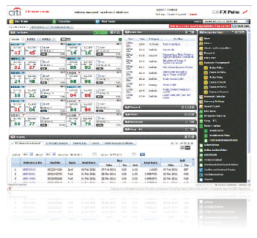
Introducing CitiFX
foreign exchange | e-commerce | structuring | corporate solutions | research | analysis
Transactions speak louder than words
Across time zones, through developing and emerging markets, clients just like you — companies, governments and institutions — draw on the expertise of our talented and diverse staff: 1,700+ FX professionals who ensure our unique presence in over 96 countries offers the unparalleled breadth and depth of knowledge that works tirelessly to realise your financial objectives. Welcome to CitiFX.
At CitiFX, we continue to shape, develop and help grow the economies and infrastructures we have a decisive presence in, driving solutions that give you the broadest possible market access, with pricing in over 100 major and exotic currencies. Offices in every major trading centre position us to capture the coverage that gives you unprecedented market access to liquidity, 24 hours a day, 6 days a week. Our product offering enables you to exploit the opportunities that help you meet tomorrow’s challenges today:
Spot, forwards and swaps
FX fixing execution
Structuring for options and derivatives
Interest-rate derivatives, both short- and long-term
Commodities and commodity derivatives
FX-linked investment products
Deal-contingent structures
CitiFX® e-Commerce
Trade volumes conducted electronically continue to expand across sectors and areas of commerce. We draw on innovations that offer you unencumbered access, liquidity and STP solutions.
CitiFX Pulse
Intelligent, user-intuitive and flexible, this state-of-the-art online infrastructure enables you to conduct real-time FX spot, forward and swap pricing in 250+ currency pairs, 24 hours a day. One of the most efficient online platforms on the market offers you the best blend of local and global pricing, CitiFX Pulse offers: streaming live rates for FX spot and forwards, online orders, block trading, real-time news, confirm and instruct and reporting functionality.
CitiFX® Benchmark
CitiFX Benchmark is an externally audited fixing of FX rates. There are 17 fixings over the 24-hour day, which are published on Reuters and Bloomberg (pages FXBENCH/FXBA). Benchmark allows for the transparent and efficient processing of large batches of trades, and provides internal control mechanisms.
CitiFX® Intelligent Orders
Our approach to execution is designed to minimise the market impact of large flows reducing average transaction costs. This approach gives you complete transparency over order execution, customisation and a comprehensive suite of post-trade reports.
Introduction to CitiFX

Slide 4
Introducing CitiFX
CitiFX–Corporate Solutions Group (CSG)
CSG serves primarily as a risk management consulting group advising our clients on all issues of FX risk management including:
  Designing currency risk management programs aligned with overall risk management objectives
  Accounting guidance and analysis and evaluation of hedging programs within the constraints of FAS133 and IAS39
  Estimation of the earnings and cash flow impacts of proposed hedging solutions
  Simulation and Scenario analysis of proposed hedging solutions utilizing Monte Carlo simulation and Back-testing
  Cost effective techniques for managing emerging market exposures
  Managing FX risk on a portfolio basis
  Hedging M&A transactions and other contingent risks
CitiFX QIS
Seeking the best way to passively and actively manage currency risk is an issue that investors are continuously working to enhance.
Citi’s Quantitative Investor Solutions group has worked for ten years with sales desks to develop a series of FX indices in G10 and EM representing strategies aimed at offering solutions for:
currency as portfolio risk, and
currency as an investment or stand alone asset class
CitiFX® Research
Preparation is a prelude to good performance, and we produce industry-leading research that covers a vast array of topics on this very principle. With flagship publications like CitiFX GEOS, and Emerging Markets Macro and Strategy Outlook, you have everything from forecasting through emerging market outlooks to technical oversight, right at your fingertips.
CitiFX GEOS provides:
Monthly global economic outlooks and strategies
Economic forecasts for all major economies and markets
Emerging Markets Macro and Strategy Outlook provides:
Monthly summary of emerging markets
Forecasts on EM exchanges and interest rates
Overviews on 36 individual EM countries
Velocity Research
Citi Velocity provides a single point of access to cross-product research, analytics, e-trading and execution services: www.citivelocity.com.
CitiFX® Wire
CitiFX Wire is located on your trading platform, delivering intraday DeskTalk and headlines, cutting-edge strategy, leading technical analysis and research. Tap into the power of all the information from our global franchise, 24-hours a day.
CitiFX® Structuring
If you are a corporate or institutional client, then our Structuring team gives you the best advice going on currency risk- management issues and products.
Working closely with our Sales desks and Corporate Solutions Group, CitiFX Structuring designs, analyses and executes tailor-made solutions for large corporations, privately and publicly owned small and mid-size corporations, asset managers, central banks and government entities, covering:
Bespoke hedging and balance-sheet solutions
Market information, ideas and commentaries
Portfolio risk analysis and restructurings
Simulation and scenario analysis
Yield enhancement and investment solutions
Funding cost reduction through FX linkage
Contact Information
Name Noel O’Reilly
Lee Aduculesi
Antonio Sanchez
Telephone +1 212 723 3945
Email citifx@citi.com
Introduction to CitiFX

Slide 5
2. Market Update

Slide 6
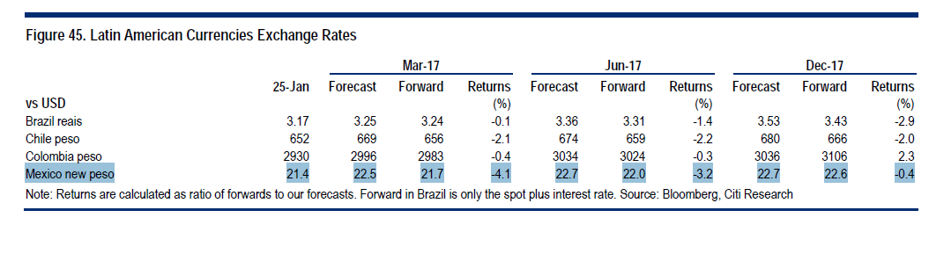
USDMXN Forecast
Uncertainty over the Trump administration’s stance continues to be an overhang on the Mexican peso.
President Nieto cancelled his meeting with President Trump, likely due to domestic political pressure
The uncertainty Mexico faces is high and it will be difficult for the peso to have a sustainable rally before NAFTA talks have even started.
We forecast USD/MXN at 22.50 over 0-3m and 22.7 over 6-12m reflecting these complicated dynamics. With no Fed action or ECB news, spot is very likely to drift higher with so much policy divergence already priced in. March ECB critical.
Citi has downgraded Mexico GDP growth forecast for 2017 from 1.8% to 1.2%.
We now sees inflation closing at 5.2% in 2017. This along with FX volatility should lead to a more restrictive stance by Banxico.
Citi expects the central bank to hike 50bps in each of the coming two meetings in Q1 and the policy rate to close the year at 7.50% (Currently at 5.75%).
*Forecasts as of January 27, 2017
Market Update

Slide 7
History Suggest Continued Dollar Appreciation in Current Cycle
Since the inception of floating currencies, peak-to-trough cycles in the USD have lasted between 6-9 years. With potentially 2-5 years remaining in current cycle, USD may strengthen by a further 10%-20%
US Dollar Since 1973
Federal Reserve US Traded Weighted Real Major Currencies Dollar Index
Federal Reserve US Trade Weighted Real Other Important Trading Partners Dollar Index
Peak-to-trough cycles in the US Major Currency Index have been between 30%-60% and have broadly been matched (with a lag) by moves in the US Other Important Trading Partners Index
6-7 years
+60% (+7.5% ann.)
8-9 years
-40% (-5% ann.)
6-7 years
+46% (+6% ann.)
8-9 years
-33% (-4% ann.)
Current: 4 years
Major TWI +38% (+9% ann.)
OITP TWI +15% (+4% ann.)
Source: Bloomberg, January 31, 2016 OITP index weightings Mexico (21%), China (37%), Taiwan (4%), Korea (7%), Singapore (3%), Hong Kong (2%), Malaysia (3%), Brazil (4%), Thailand (2%), Philippines (1%), Indonesia (2%), India (3%), Israel (2%), Saudi Arabia (2%), Russia (2%), Argentina (1%), Venezuela (1%), Chile (2%), Colombia (1%)

Slide 8
3. CitiFX Risk Management

Slide 9
Defining the FX Exposure
For multinational corporations, there are two types of FX exposures
  The FX risk that a corporation faces is always defined with respect to its functional currency
  For multinational corporations, FX exposure identification is a two-step process
  Transactional Exposures
    Non-functional currency denominated transactions which may include: forecasted revenues and expenses; forecasted and existing foreign-currency-denominated assets and liabilities, i.e. payables and receivables, and lending and borrowing activities.
    Changes in exchange rates will have an impact on cash flows and on the earnings of the entity that owns the exposures. These transactions may include both third-party and inter-company exposures.
  Translation Exposures
    For purposes of consolidating financial results for reporting purposes, the income statements and balance sheets of foreign subsidiaries are translated to the parent company’s reporting currency at the current exchange rate.
    Changes in exchange rates will have an impact on the following:
      The value of the parent company’s consolidated net investment position in its foreign operations, with translation gains and losses recorded in the Currency Translation Account (CTA) as part of equity
      The value of translated earnings of foreign subsidiaries in consolidation
  Once exposures are identified, organize them by exposure type and currency pair
  Each exposure type should have its own forecast
  Afterwards, an essential step is quantifying the amount of risk the company’s has from these different FX exposures
In addition to identifying the exposures, specify over what period of time that risk would be evaluated and hedged

Slide 10
Risk Management Objectives
A corporation’s risk management objective may be both reducing variance and minimizing y-o-y volatility
Reducing risk over a discrete time period is the most predominant risk management objective among our corporate respondents
Minimizing period-on-period volatility in either cash flows or earnings was also mentioned as a risk management objective for 36% of the respondents
Risk Management Objective
Reducing risk over a discrete period
Reducing period-on-period volatility

Slide 11
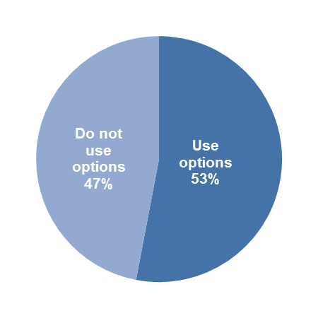
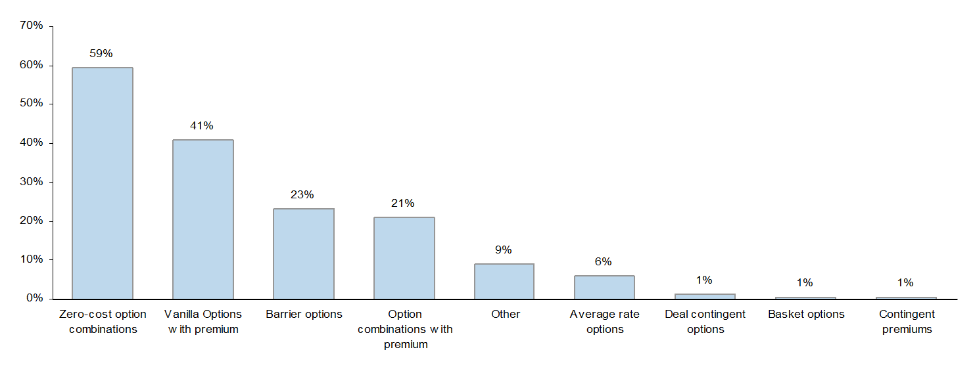
Companies Using FX Options for Hedging
Approximately half of survey respondents say they use options in their hedge program
On an aggregate basis, more than half of companies use options
A majority respondents (59%) that use options utilize zero-cost option combinations while 62% spend option premium on vanilla options and/or option combination structures
Are FX Options Part of Hedge Program?
Types of Option Hedging Strategies

Slide 12
Options vs. Forwards
 | Forwards | Options
Definition | Agreement that creates the obligation to deliver one currency for another on a certain date at a certain rate | Contract that gives the owner the right but not obligation to deliver one currency for another at a certain date at a certain rate
Hedge Objective | Lock in the USD value of future foreign currency cash flows | Guarantee the maximum costs of future foreign currency cash flows, in the example of a liability, while maintaining upside potential for currency appreciation
When | Exposure is well known | Exposure is uncertain
 | Exposure has a symmetric risk profile | Exposure has an asymmetric risk profile
 | Market view: neutral or negative | Market view: upside potential seen
Characteristics | No upfront cost | Upfront cost
 | Cost reflects the interest rate differential | Cost reflects the average expected payout of the option at expiration
 | Very FAS133 friendly | FAS133 friendly in most cash flow hedge relationships, especially under G20
 | Inflexible—unwinding means paying the full MTM loss | Permits the ability to manage the hedge as the moneyness of the option changes. It can also be structured to offset from specific currency risks
Appendix

Slide 13
4. CitiFX Awards

Slide 14
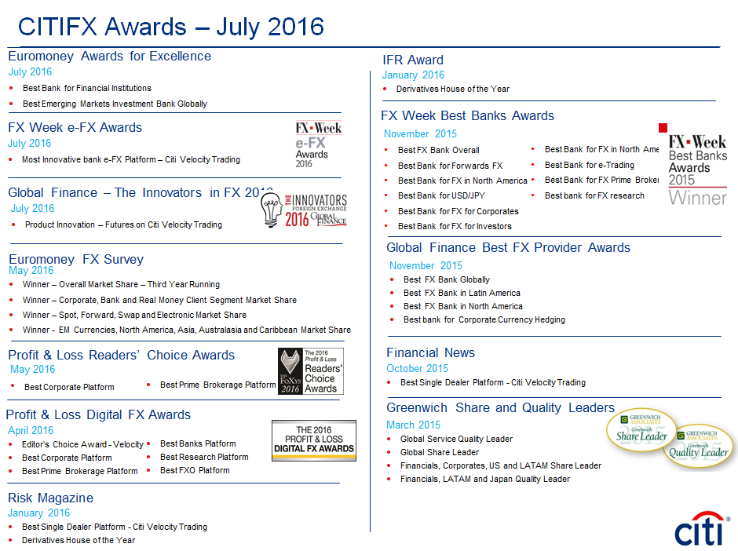

Slide 15
Disclosures
Disclaimer
This communication is issued by a member of the sales and trading department of Citibank, N.A. or one of its affiliates (collectively, “Citi”). Sales and trading department personnel are not research analysts, and the information in this communication (“Communication”) is not intended to constitute “research” as that term is defined by applicable regulations. Unless otherwise indicated, any reference to a research report or research recommendation is not intended to represent the whole report and is not in itself considered a recommendation or research report. All views, opinions and estimates expressed in this Communication (i) may change without notice and (ii) may differ from those views, opinions and estimates held or expressed by Citi or other Citi personnel.
This Communication is provided for information and discussion purposes only. Unless otherwise indicated, it does not constitute an offer or solicitation to purchase or sell any
financial instruments or other products and is not intended as an official confirmation of any transaction. Unless otherwise expressly indicated, this Communication does not
take into account the investment objectives or financial situation of any particular person. Recipients of this Communication should obtain advice based on their own individual
circumstances from their own tax, financial, legal and other advisors before making an investment decision, and only make such decisions on the basis of the investor's own
objectives, experience and resources. The information contained in this Communication is based on generally available information and, although obtained from sources
believed by Citi to be reliable, its accuracy and completeness cannot be assured, and such information may be incomplete or condensed. Citi has no responsibility to update the material contained in this communication.
Citi often acts as an issuer of financial instruments and other products, acts as a market maker and trades as principal in many different financial instruments and other products,
and can be expected to perform or seek to perform investment banking and other services for the issuer of such financial instruments or other products.
The author of this Communication may have discussed the information contained therein with others within or outside Citi and the author and/or such other Citi personnel may
have already acted on the basis of this information (including by trading for Citi's proprietary accounts or communicating the information contained herein to other
customers of Citi). Citi, Citi's personnel (including those with whom the author may have consulted in the preparation of this communication), and other customers of Citi may be
long or short the financial instruments or other products referred to in this Communication, may have acquired such positions at prices and market conditions that
are no longer available, and may have interests different from or adverse to your interests.
Investments in financial instruments or other products carry significant risk, including the possible loss of the principal amount invested. Financial instruments or other products
denominated in a foreign currency are subject to exchange rate fluctuations, which may have an adverse effect on the price or value of an investment in such products. No
liability is accepted by Citi for any loss (whether direct, indirect or consequential) that may arise from any use of the information contained in or derived from this
Communication.
Past performance is not a guarantee or indication of future results. Any prices provided in this Communication (other than those that are identified as being historical) are
indicative only and do not represent firm quotes as to either price or size. You should contact your local representative directly if you are interested in buying or selling any
financial instrument or other product or pursuing any trading strategy that may be mentioned in this Communication.
Although Citibank, N.A. (together with its subsidiaries and branches worldwide, "Citibank") is an affiliate of Citi, you should be aware that none of the financial
instruments or other products mentioned in this Communication (unless expressly stated otherwise) are (i) insured by the Federal Deposit Insurance Corporation or any other
governmental authority, or (ii) deposits or other obligations of, or guaranteed by, Citibank or any other insured depository institution.
IRS Circular 230 Disclosure: Citi and its employees are not in the business of providing, and do not provide, tax or legal advice to any taxpayer outside of Citi. Any
statements in this Communication to tax matters were not intended or written to be used, and cannot be used or relied upon, by any taxpayer for the purpose of avoiding tax
penalties. Any such taxpayer should seek advice based on the taxpayer’s particular circumstances from an independent tax advisor.
© 2014 Citigroup Inc. CitiFX, CitiFX Pulse, Citi and Citi and Arc Design are trademarks and service marks of Citigroup Inc.

