Slide 1
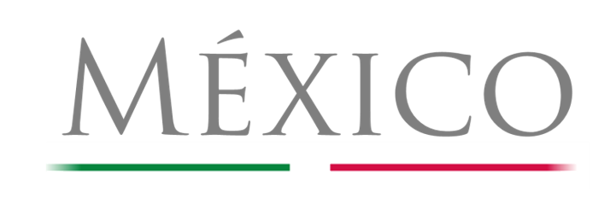

Slide 2
WI
MI
NE
IA
OH
IN
KS
MO
OK
AR
AZ
TX
Mexico is their 2nd largest export market
Source: Ministry of Economy.
Notes:
Mexico ranks among the top 3 export markets for 33 states
6 million U.S. jobs depend on trade in goods and services with Mexico

Slide 3
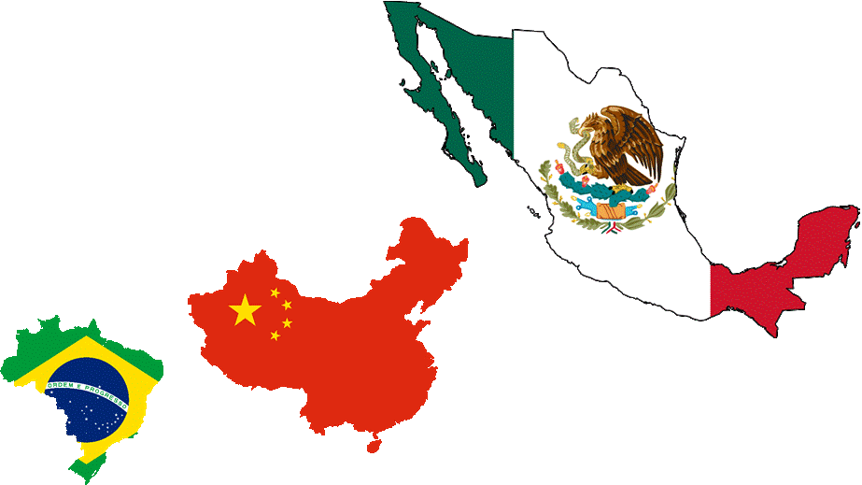
Mexico: Second largest buyer to the U.S
2x
5x
Source: SE- NAFTA with data from Wisertrade.
Notes:
Mas que los BRICS combined or UK, Germany and France
These exports are important because Mexico, the United States and Canada jointly manufacture products.
In fact, 40% of the content of Mexican exports is originally made in the U.S. (Canada 25% and China 4%).

Slide 4
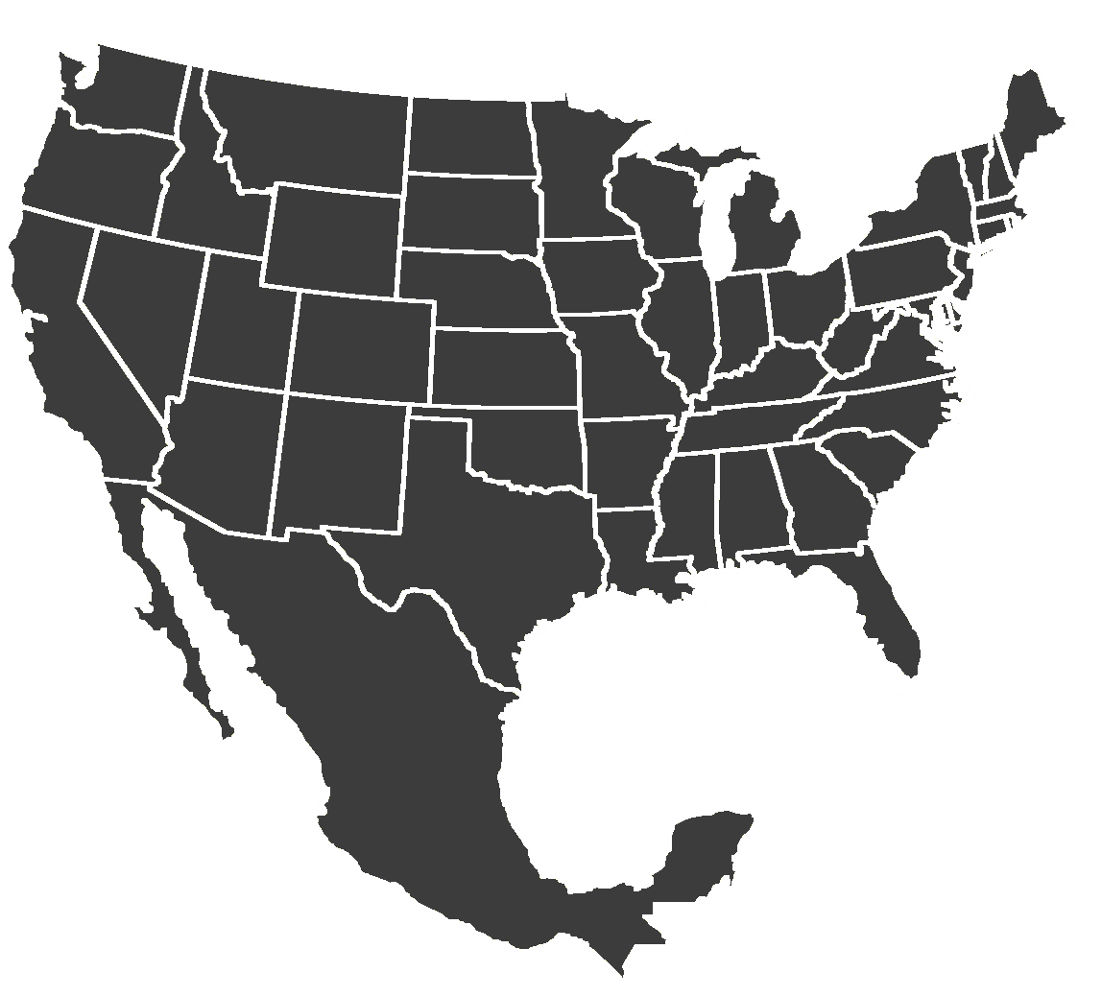
The Importance of NAFTA
$530
$290
$99
Notes:
NAFTA represented a change of paradigm in regional integration; innovative and unprecedented for its time.
Let me share with you some relevant figures:
The NAFTA is the largest FTA globally.
The total population of the region sums more than 474.25 million people.
NAFTA represents a GDP of 20.5 billion dollars.
Thus, just over 26% of the world’s GDP.
Exports among members are estimated at over 140 million dollars per hour.
ECONMIC INTEGRATION/ MOST COMPETITIVE REGION IN THE WORLD

Slide 5





US
Trade
Deficits
60%
40%
35%
47%
25%
12%
9%
9%
9%
4%
Mexico
KOREA
JAPAN
GERMANY
CHINA

Slide 6

NAFTA’S intra-regional trade
Mining
Transportation Equipment and Machinery
41
749
Pharmaceutical
Oil, gas and mineral fuels
28
in
24
569
hours
Medical devices
(in MUSD)
39
Agrifood
259
Appliances
Chemicals
29
62
Source: ProMéxico with information of GTA.
Notes:
NAFTA countries move about half of its exports intra-regionally.
1 in 4 exports we trade intra-regionally come from the automotive and auto parts sector.

Slide 7

Auto parts travel
across the border
8 times before
completing a single vehicle.
x8
Source: ProMéxico with information from BCG.
Notes:
40% American Content

Slide 8
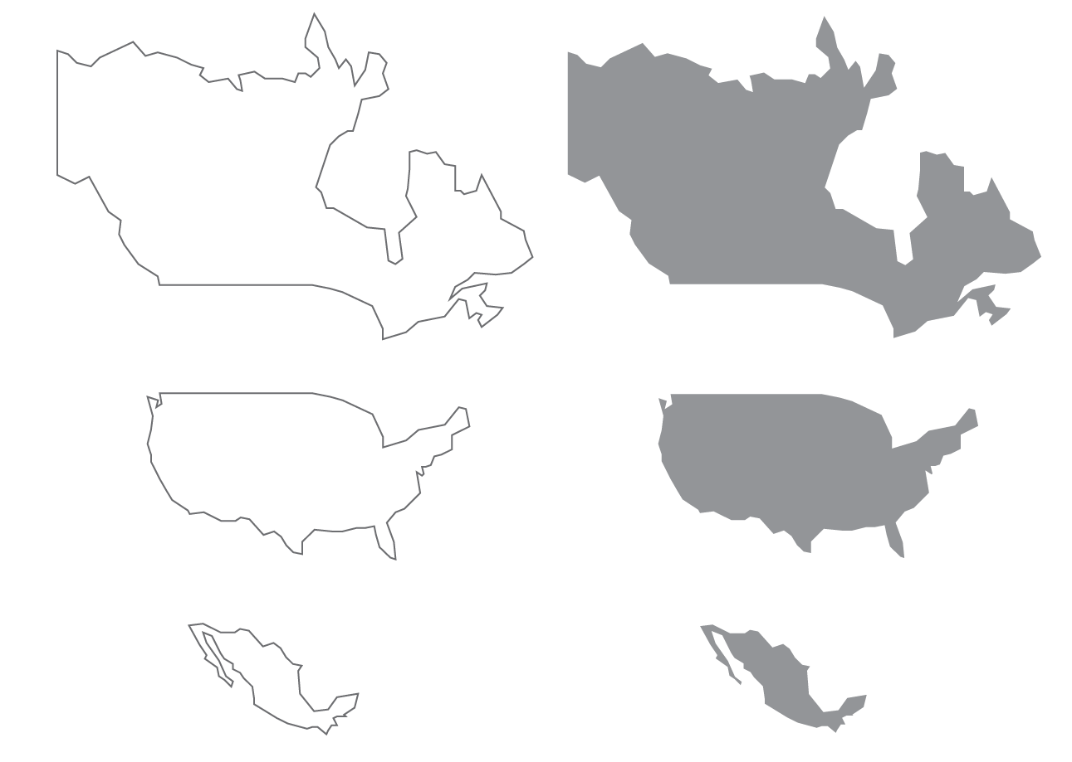

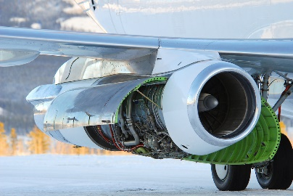


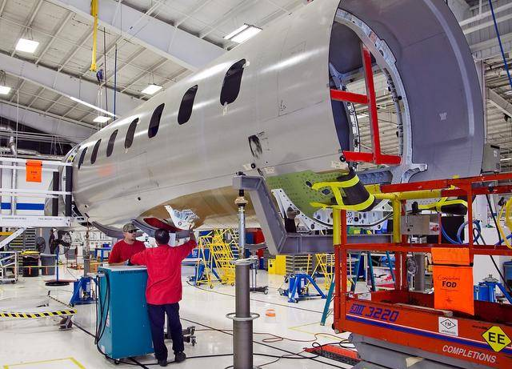
Montreal
Wichita
Queretaro

Slide 9
FDI flows into Mexico (1999-2016)
MDD
44,199
29,032
22,568
24,706*
1999
2000
2001
2002
2003
2004
2005
2006
2007
2008
2009
2010
2011
2012
2013
2014
2015
2016
Notes:
Mexico attracted 22.568 million dollars in foreign direct investment in 2014.
And is expected to reach about 25,000 million in 2015.

Slide 10
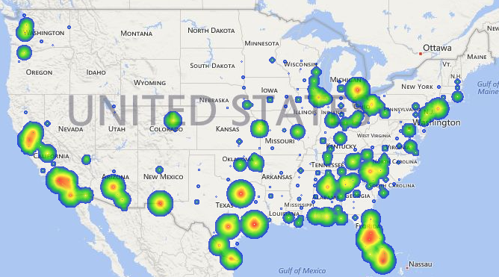
Mexican companies investing and
creating jobs across the U.S.
Mexican companies in the U.S.
(density)
More than $40 USD Billion in FDI in the last 5 years
Operate more than 6,500 businesses in the U.S.
Creating more than 122,000 jobs
10
Source: SE-Washington with information from iMap 2015. FDI figure from Bilateral FDI Statistics 2014 by the UNCTAD, using a historical-cost basis 2012

Slide 11
takeaways
North America competes globally as a region, not as individual nations
NAFTA allowed companies to become more competitive by integrating supply chains
NAFTA needs to be modernized to address the current economic and business environment
It is more than an fta, it is an institution that provides certainty and legal framework
11

