Slide 1
Miller, Canfield, Paddock and Stone, PLC “The Outlook for U.S. Corporate Tax Reform, Border Adjustments and Trade Actions”
June 2017

Slide 2
Miller Canfield
Miller Canfield founded 1852 in Detroit
250+ lawyers and legal assistants with global footprint
Offices: United States, Canada, Mexico, Poland, China
The Legal Alliance of Americas
Other Affiliations in India, Europe, Asia
100+ attorneys included in most prestigious legal referral guides
Aligning our Practice with Your Business
Global Coverage for Auto and Manufacturing Industry
Directly Responsive
Best Practices: Cost Effective and Efficient

Slide 3
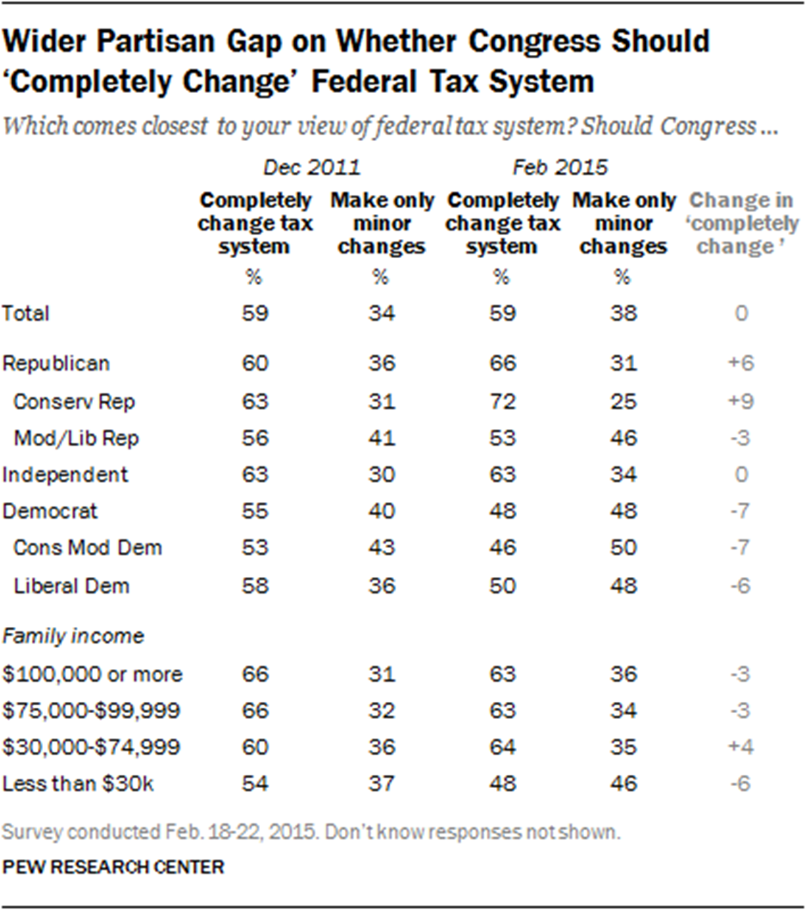
Need for Tax Reform?

Slide 4
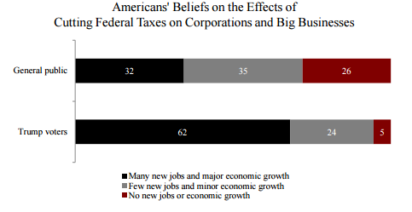
Need for Tax Reform?

Slide 5
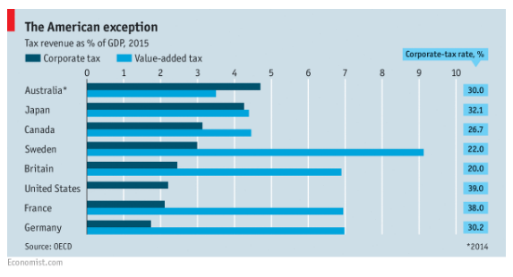
Need for Tax Reform?

Slide 6
Corporate Tax Reform Proposals
Trump Campaign
Corporate Rate 15%
Lower corporate income tax (income retained in business; possibly supplement with border duties
House GOP
(Ryan/Brady)
Corporate Rate 20%
Destination based cash-flow (border adjusted) tax
Lower corporate income tax rates
? %
Senate (Hatch)
Pass-Through Rate 15%
Pass-Through Rate 25%

Slide 7
Corporate Tax Reform Proposals
BAT initially proposed by GOP, not Trump Administration
Reps. Paul Ryan (Speaker of House) and Kevin Brady (Chairman of House Ways and Means Committee)
Released framework in June 2016 Paper: “A Better Way: a Pro-Growth Tax Plan for All Americans”
Trump Campaign Tax Reform Pledges
Reduce CIT rate from 35% to 15%
Reduce rate to 10% for U.S. companies repatriating profits
Campaign did not include border-adjustment features of tax, but rather higher duties on imports (esp. from Mexico and China)
Senate (Hatch) tax reform proposal not getting attention

Slide 8
Key Features of BAT
Technically, “destination-based cash-flow tax”
Replacement for corporate income tax
Single rate – presently advertised at 20%
“Cash-flow” feature
Businesses can fully expense capital investments, rather than depreciate over number of years
Retain deduction for wages (can be understood as a 20% “subsidy” for U.S. payrolls, relative to VAT)
And…

Slide 9
Key Features of BAT
“Destination-based” (Border Adjustment) feature
Changes CIT from “source-based” to “destination based”
Business taxed imposed based on place of consumption of goods and services, but on source of income and location of purchaser
20% Tax Imposed on
Domestic (U.S.) Revenues Less Domestic (U.S.) Costs
No deduction for costs of imported goods or services
Revenue derived from exports not taxed (tax imposed only on goods/services consumed in U.S.)
Encourages exports
Encourages repatriation of foreign profits

Slide 10
Key Features of BAT: Costs of Imports
Question: Won’t imported goods become too expensive?
Answer: No, because USD expected to appreciate
Economists predict rapid appreciation of USD of 25%
Other examples: when VAT border-adjustment features adopted by countries; immediate depreciation of British pound upon Brexit vote (over 10%)
Predicted Effect: 25% appreciation of USD should fully neutralize affect on U.S. company’s profitability

Slide 11
Key Features of BAT: Sample Profit/Loss
 |  |  | No BAT, but Reduced CIT Rate (20%) | With BAT (no USD appreciation) | With BAT (25% USD appreciation)
Revenues
 | Domestic sales |  | $1,000 | $1,000 | $1,000
 | Foreign sales |  | $0 | $0 | $0
Costs
 | Domestic inputs |  | $300 | $300 | $300
 | Foreign inputs |  | $300 | $300 | $240
Pre-tax income |  |  | $400 | $400 | $460
Taxable income |  |  | $400 | $700 | $700
Tax (20%) |  |  | $80 | $140 | $140
After-tax income |  |  | $320 | $260 | $320

Slide 12
Challenges in Implementing…
Big Policy Questions Clouding Prospects:
Extent and duration of USD appreciation source of most of the apprehension
Inflationary effect on U.S. economy
Big Political Questions Clouding Prospects:
Affordable Care Act hangover
Where is President Trump on issue? Will he “own” it?
Split of conservatives/Republicans
Strong lobbying against BAT (esp. retail)
Legislative process

Slide 13
Who Favors/Opposes BAT? Current Scorecard…
Favor BAT
Oppose BAT
Paul Ryan (Speaker of House)
Kevin Brady (Chair, House Ways & Means)
Peter Navarro (President’s National Trade Council and econ. advisor)
Grover Norquist (Americans for Tax Reform)
Stephen Bannon (Presidential Advisor)
Wilbur Ross (Sec. of Commerce)?
Gary Cohn (Pres. chief economic advisor)
Americans for Prosperity (Koch brothers)
Senator Tom Cotton (R-Arkansas)
Retailers
Other conservative groups
Democrats (?)
Many other countries
Unclear/Undecided
President Trump

Slide 14
Possible Outcomes of BAT Implementation
Phase-in BAT:
Transition period to allow U.S. companies period of time to adjust (3-5 years)
Example: ratchet-down deductibility of imported goods over period of years
Brady – Top House Rep. Legislator
5 year phase-in
Modify which/how imported goods are deductible
Industry specific (e.g., relief for retail sector)
Make certain imports partially deductible for period
Index deductibility to USD appreciation

Slide 15
Legality of BAT
World Trade Organization prior rulings
WTO has approved border tax adjustments in context of “indirect taxes”, such as VAT, sales, excise taxes
WTO has said border adjustments not applicable to “direct taxes” like income taxes, but has not yet ruled in such a case
WTO principles of non-discrimination
Any tax must be levied on imported goods at same rate as on like domestic goods
Any border adjustment must not subsidize exports
Potential legal problem with BAT: costs of labor
Not deductible for imported goods, but deductible for US goods
Unlike a credit-invoice VAT, which does not deduct labor costs on domestic or imported products

Slide 16
Legality of BAT
Consequences of WTO challenge
Probability that BAT would violate existing WTO rules, but not certain
In any case, even if BAT challenged in WTO:
Process lengthy (at least 3 years)
Trump Administration could simply ignore, pull-out U.S.
Other legal challenges with bilateral U.S. tax treaties, if BAT considered an income tax
Challenge under NAFTA?

Slide 17
Renegotiation of NAFTA: Timetable
May 18
July 17
August 16
USTR sends formal notice to Congress of US’ intent to renegotiate NAFTA
Shortly thereafter, USTR requests comments on NAFTA negotiation
(30 days prior to end of 90 day period)
90 day consultation period begins
US to present to congress a detailed analysis of terms and objectives of negotiation
Public
End of 90 day consultation period
Initiation of negotiation between three countries

Slide 18
Renegotiation of NAFTA: Timetable
Fall
Mexican Presidential Primaries begin
Winter
US and Mexican authorities hope to have major NAFTA points ironed out
Summer
July 1, 2018: Mexican Presidential Elections
Tax Reform likely to be in Congress (WR: healthcare – scoring system)
Similar for Tax Reform
Nov. 6, 2018: US Mid-Term Elections
Fall
Spring
WR: NAFTA negotiations most likely to extend to 2018

Slide 19
Renegotiation of NAFTA: Wilbur Ross
“Outdated, at best”
Services, including Financial Services
Digital Economy
Natural Resources (in part, thanks to Mexican reforms)
[Environmental Matters]
“Re-provisioning to adjust to Economic Realities”
Rules of Origin – automotive industry

Slide 20
Private Sector
GE
Invest and set up operations in the market you want to be.
Where you set up a factory is a hugely strategic call.
Globalization effect: from 80% US to 70% Global
Pros: FDI, level the playing field, reduce trade deficits
Immigration: open to free flow of labor
GM
Pros: regulatory environment, tax reform, infrastructure
Immigration: key educational opportunities, key contacts in operations

Slide 21
Other Possibilities: Anti-dumping Self-Initiation
U.S. Tariff Act of 1930: Government can impose duties on imported goods to protect U.S. industries from injury and unfair competitive advantages caused by either or both:
Foreign price discrimination (dumping goods in US market by selling them at less than fair market value)
Certain foreign subsidies that allow importers to sell goods in US at less than fair market value (countervailing duties)
US – China – Mexico (back-door antidumping)

Slide 22
Other Possibilities: Anti-dumping Self-Initiation
Current practice has been for Dept. of Commerce to initiate anti-dumping investigation after petition filed by aggrieved U.S. party/industry
But Dept. of Commerce can initiate anti-dumping investigations on its own (without private party petition)
Antidumping duties calculated as a percentage of the imported good's value, equal to the good's dumping margin (possible for the dumping margin to exceed 100% of the good's value)
US Customs then collects duties when the goods are imported
Self-initiation controversial, but strong signs that this will happen in Trump Administration

Slide 23
Other Possibilities: Section 337 Investigations
Typically used by U.S. International Trade Commission to investigate unfair trade practices relating to IP infringement
But can be used in other contexts
Example: U.S. Steel filed Section 337 complaint against all Chinese importers of carbon and alloy steel products
Claims based on antitrust practices to fix prices and control output and export volumes, misappropriating trade secrets, and falsely designate country of origin
Remedy can be drastic: could prohibit an entire country’s industry from importing product into U.S.

Slide 24
Miller Canfield
Margarita M. Escalante
escalante@millercanfield.com

